Slide 1
FARMER ASSISTANT PORTAL

Slide 2
INDEX
Abstract
Objective of project
Problem Statement
Scope & Motivation
Introduction
Literature survey
Existing Method
Disadvantages
Proposed method
Advantages
Project Flow
Hardware and Software Requirements
Architecture
Modules
References

Slide 3
ABSTRACT
The amazing developments in science and technology have raised the bar for human living standards. Without these improvements, the entire planet will be physically congested. Compared to other projects now in existence, this project is innovative in that it simplifies the process of getting farming. Java has been used to implement this project. The project's goal is to create an application software to lessen the human labour involved in keeping track of the farming of different crops consumed by people and getting farming on different ways based on seasonal wise. The fast changing environment, including difficult market conditions and a high exposure to financial risks are major reasons for changing production policy. Farm Management Systems appear to be a powerful tool to deal with the new conditions. However, farmers still rely more on their intuition than on proper management tools, when it comes to running a farm business. Many farmers do not use Farm management for various reasons, like lack of knowledge and the complexity of many available farm managements. In particular for small to medium-sized farms and for multifunctional farms appropriate farm management hardly exist.
Keywords: Farming, Crops, Products , Admin, Customer, Orders etc.

Slide 4
OBJECTIVE OF PROJECT
The objective of the Farmer Assistant Portal project is to empower farmers with the knowledge and resources they need to make informed decisions, implement modern practices, and thrive in their agricultural pursuits, thereby creating a positive impact on their lives and the agricultural sector as a whole.

Slide 5
PROBLEM STATEMENT
The successful implementation of the Farmer Assistant Portal will empower farmers with knowledge, resources, and connections necessary to thrive in their agricultural pursuits. This digital solution has the potential to elevate agricultural productivity, boost rural economies, foster sustainable practices, and enhance the overall quality of life for farmers and their communities.

Slide 6
SCOPE AND MOTIVATION
Motivation:- The motivation for a Farmer Assistant Portal lies in improving the well-being and prosperity of farmers by providing them with resources, information, and opportunities that can positively impact their agricultural practices and quality of life.. Scope:- The scope of the Farmer Assistant Portal is vast, aiming to provide a holistic solution that empowers farmers with the tools, knowledge, and connections they need to enhance their agricultural practices, increase productivity, and improve their livelihoods. The specific scope can be tailored based on the target audience, geographical region, and technological capabilities.

Slide 7
INTRODUCTION
Introduction to the "Employee Management System" Project:
In today's dynamic and competitive business landscape, managing employees effectively is crucial for the success of any organization. As companies grow in size and complexity, traditional manual approaches to employee management become increasingly challenging and time-consuming. This is where an Employee Management System comes into play.
An Employee Management System is a comprehensive software solution designed to streamline and automate various HR processes, enabling organizations to efficiently manage their workforce from recruitment to retirement. It serves as a centralized platform that integrates multiple functions, including employee data management, attendance tracking, leave management, payroll processing, performance evaluation, training and development, and more.

Slide 8
INTRODUCTION
Introduction to the "Farmer assistant portal" Project:
An innovative and empowering platform designed to revolutionize the way farmers interact with technology and information. In today's rapidly evolving world, where agriculture plays a pivotal role in sustaining global populations, our Farmer Assistant Portal emerges as a beacon of support for farmers worldwide.
In this interconnected era, harnessing the power of technology is crucial for optimizing agricultural processes, increasing productivity, and ensuring sustainable practices. The Farmer Assistant Portal Project is a visionary initiative aimed at bridging the gap between traditional farming practices and cutting-edge technology. By providing farmers with a comprehensive digital toolkit, this platform strives to enhance efficiency, knowledge-sharing, and ultimately, the livelihoods of those who feed the world.

Slide 9
LITERATURE SURVEY
S.NO | YEAR | AUTHORS | TITLE | OUT COMES
1 | 2011 | Manav Singhal, Kshitij Verma, Anupam Shukla | Krishi Ville-Android based solution for Indian agriculture | Information and Communication Technology (ICT) in agriculture is an emerging field focusing on the enhancement of agricultural and rural development in India
2 | 2014 | Soumalya Ghosh, A. B. Garg, Sayan Sarcar, P.S.V.S Sridhar | Krishi-Bharati: An Interface for Indian Farmer | The system is also a good platform for selling farmer's production and buying material from vendors, which is necessary for farming. Farmers can also buy or sell new or old agricultural machinery that are used in farms like cultivators,

Slide 10
LITERATURE SURVEY
S.NO | YEAR | AUTHORS | TITLE | OUT COMES
3 | 2019 | Shankar M. Patil, Monika Jadhav, Vishakha Jagtap | Android Application for Farmers | Agriculture is a top priority in India but today the people involved in agriculture are of a lower class and face a lot of trouble in their day to day life due to extreme poverty
4 | 2018 | Shital Chaudhari, Vaishnavi Mhatre, Pooja Patil | International Research Journal of Engineering | The farmers, who were dependent on clouds for rain, now are looking into the Cloud Computing for their solutions towards cultivation of superior crops in today’s modern agricultural world.

Slide 11
LITERATURE SURVEY
S.NO | YEAR | AUTHORS | TITLE | OUT COMES
5 | 2015 | Arpit Narechania | KisanVikas – Android Based ICT Solution in Indian Agriculture to Assist Farmers | Agriculture accounts for ~15% of the Gross Domestic Product (GDP) of India but employs close to 50% of the working population.
6 | 2020 | Shaik. N. Meera, Anita Jhamtani | Information and Communication Technology in Agricultural Development | The study points out that low coverage, low operational performance, low participation of volunteer farmers, low awareness of farmers, low access of farmers to institutional credit.

Slide 12
LITERATURE SURVEY
A literature survey for a farmer assistant portal would involve reviewing existing research, studies, and articles related to similar platforms or technologies designed to assist farmers. This survey helps identify gaps in the current knowledge, understand the challenges faced by farmers, and gather insights for the development and enhancement of the portal. Remember that the content and depth of your literature survey will depend on the specific focus of your research and the scope of the farmer assistant portal you are working on. Make sure to cite and reference all the sources you review to provide credibility to your survey findings.

Slide 13
EXISTING SYSTEM
People now a days use a manual process for buying products and required things, due to some reasons. They have got used to the manual process and they can go along with it even though there are concerns associated with it. They are reluctant to change their current process since it will be an extra effort. The farm management for a new solution. However, the customers face immense problems with the current procedure of using this manual process to getting formation items.

Slide 14
DISADVANTAGES
1. Not User Friendly: The existing system is not user friendly because the retrieval of data is very slow and data is not maintained efficiently.
2. Difficulty in report generating: We can’t able see the all the tourism places information. And the people not get at the time of searching for tour.
3. Manual control: people may be get some wrong information from diffrent resources .
4. Time consuming: Every work is done manually so we cannot get the information in the middle of the tour or as per the requirement because it is very time consuming.

Slide 15
PROPOSED METHOD
To overcome the problem with an existing system, we are implementing an application called farm management system using java. Using this application customers can get all the products information via through his own accounts. After that customer can able to add products to the cart and buy the required things through online.

Slide 16
ADVANTAGES
1. User Friendly: - The proposed system is user friendly because the retrieval and storing of data is fast and data is maintained efficiently. Moreover the graphical user interface is provided in the proposed system, which provides user to deal with the system very easily.
2. Reports are easily generated: reports can be easily generated in the proposed system so user can get information at anytime

Slide 17
ADVANTAGES
3. Very less work: The proposed system requires very less work. All the data is fetched into the computer immediately and reports can be generated through computers. Moreover work becomes very easy because there is no need to keep data on papers.
4. Computer operator control: Computer operator control will be there so no chance of errors. Moreover storing and retrieving of information is easy. So work can be done speedily and in time.

Slide 18
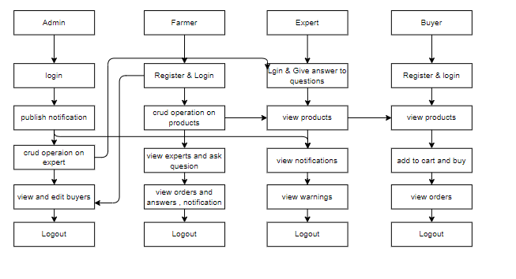
PROJECT FLLOW
Figure: work Flow of Proposed system

Slide 19
HARDWARE & SOFTWARE REQUIREMENTS
SOFTWARE REQUIREMENS
Operating System : Windows 7/8/10
Server side Script : HTML, CSS, Bootstrap & JS
Programming Language : JAVA
Libraries/Framework : Spring Boot
IDE/Workbench : Intellij IDEA

Slide 20
HARDWARE & SOFTWARE REQUIREMENTS
SOFTWARE REQUIREMENS
Technology : Java
Server Deployment : Tomacat Server
Database : MY SQL

Slide 21
HARDWARE & SOFTWARE REQUIREMENTS
HARDWARE REQUIREMENTS
Processor - I3/Intel Processor
RAM - 4GB (min)
Hard Disk - 128 GB
Key Board - Standard Windows Keyboard
Mouse - Two or Three Button Mouse
Monitor - Any

Slide 22
FUNCTIONAL AND NON-FUNCTIONAL REQUIREMENTS
Requirement’s analysis is very critical process that enables the success of a system or software project to be assessed. Requirements are generally split into two types: Functional and non-functional requirements.
Functional Requirements: These are the requirements that the end user specifically demands as basic facilities that the system should offer. All these functionalities need to be necessarily incorporated into the system as a part of the contract. These are represented or stated in the form of input to be given to the system, the operation performed and the output expected. They are basically the requirements stated by the user which one can see directly in the final product, unlike the non-functional requirements.

Slide 23
FUNCTIONAL AND NON-FUNCTIONAL REQUIREMENTS
Examples of functional requirements:
Authentication of user whenever he/she logs into the system
System shutdown in case of a cyber-attack
A verification email is sent to user whenever he/she register for the first time on some software system.
Non-functional requirements: These are basically the quality constraints that the system must satisfy according to the project contract. The priority or extent to which these factors are implemented varies from one project to other. They are also called non-behavioral requirements.

Slide 24
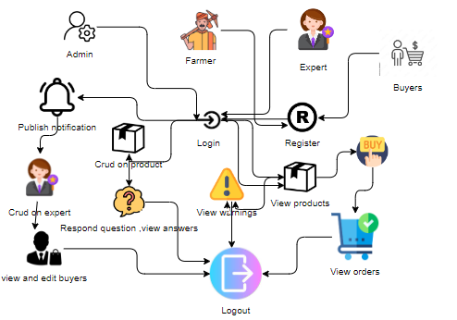
ARCHITECTURE

Slide 25
UML DIAGRAMS
Use Case Diagram:
A use case diagram in the Unified Modeling Language (UML) is a type of behavioral diagram defined by and created from a Use-case analysis. Its purpose is to present a graphical overview of the functionality provided by a system in terms of actors, their goals (represented as use cases), and any dependencies between those use cases. The main purpose of a use case diagram is to show what system functions are performed for which actor. Roles of the actors in the system can be depicted.

Slide 26
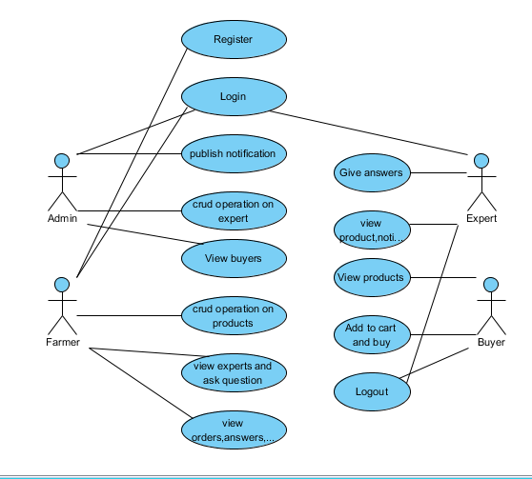
UML DIAGRAMS
Figure: Use Case Diagram

Slide 27
UML DIAGRAMS
Class Diagram:
In software engineering, a class diagram in the Unified Modelling Language (UML) is a type of static structure diagram that describes the structure of a system by showing the system's classes, their attributes, operations (or methods), and the relationships among the classes. It explains which class contains information.

Slide 28
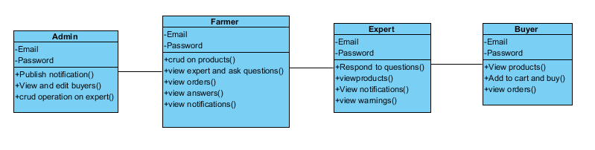
UML DIAGRAMS
Figure: Class diagram

Slide 29
UML DIAGRAMS
Sequence Diagram:
A sequence diagram in Unified Modelling Language (UML) is a kind of interaction diagram that shows how processes operate with one another and in what order. It is a construct of a Message Sequence Chart. Sequence diagrams are sometimes called event diagrams, event scenarios, and timing diagrams.

Slide 30
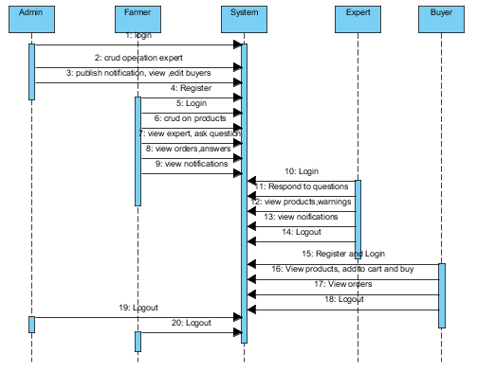
UML DIAGRAMS
Figure: Sequence diagram

Slide 31
UML DIAGRAMS
Collaboration Diagram:
In collaboration diagram the method call sequence is indicated by some numbering technique as shown below. The number indicates how the methods are called one after another. We have taken the same order management system to describe the collaboration diagram. The method calls are similar to that of a sequence diagram. But the difference is that the sequence diagram does not describe the object organization whereas the collaboration diagram shows the object organization.

Slide 32
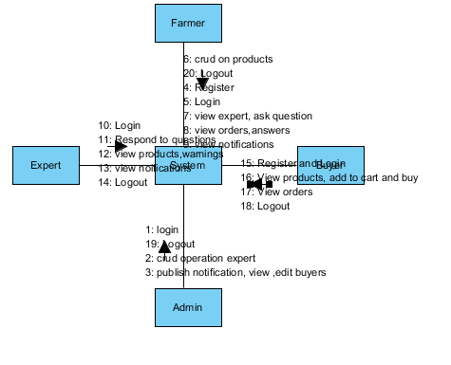
UML DIAGRAMS
Figure: Collaboration diagram

Slide 33
UML DIAGRAMS
Deployment Diagram
Deployment diagram represents the deployment view of a system. It is related to the component diagram. Because the components are deployed using the deployment diagrams. A deployment diagram consists of nodes. Nodes are nothing but physical hardware’s used to deploy the application.

Slide 34
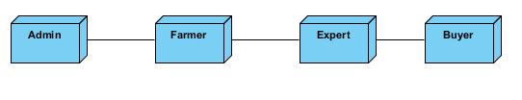
UML DIAGRAMS
Figure: Deployment diagram

Slide 35
UML DIAGRAMS
Activity Diagram:
Activity diagrams are graphical representations of workflows of stepwise activities and actions with support for choice, iteration and concurrency. In the Unified Modelling Language, activity diagrams can be used to describe the business and operational step-by-step workflows of components in a system. An activity diagram shows the overall flow of control.

Slide 36
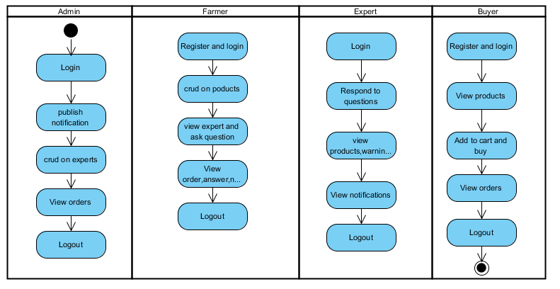
UML DIAGRAMS
Figure: Activity diagram

Slide 37
UML DIAGRAMS
Component Diagram:
A component diagram, also known as a UML component diagram, describes the organization and wiring of the physical components in a system. Component diagrams are often drawn to help model implementation details and double-check that every aspect of the system's required functions is covered by planned development.

Slide 38
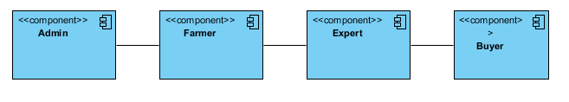
UML DIAGRAMS
Figure: Component diagram

Slide 39
UML DIAGRAMS
ER Diagram:
An Entity–relationship model (ER model) describes the structure of a database with the help of a diagram, which is known as Entity Relationship Diagram (ER Diagram). An ER model is a design or blueprint of a database that can later be implemented as a database. The main components of E-R model are: entity set and relationship set.
An ER diagram shows the relationship among entity sets. An entity set is a group of similar entities and these entities can have attributes. In terms of DBMS, an entity is a table or attribute of a table in database, so by showing relationship among tables and their attributes, ER diagram shows the complete logical structure of a database. Let’s have a look at a simple ER diagram to understand this concept.

Slide 40
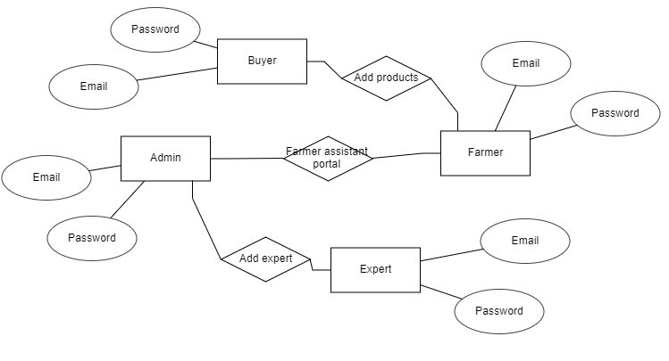
UML DIAGRAMS
Figure: ER diagram

Slide 41
UML DIAGRAMS
DFD Diagram:
A Data Flow Diagram (DFD) is a traditional way to visualize the information flows within a system. A neat and clear DFD can depict a good amount of the system requirements graphically. It can be manual, automated, or a combination of both. It shows how information enters and leaves the system, what changes the information and where information is stored. The purpose of a DFD is to show the scope and boundaries of a system as a whole. It may be used as a communications tool between a systems analyst and any person who plays a part in the system that acts as the starting point for redesigning a system.

Slide 42
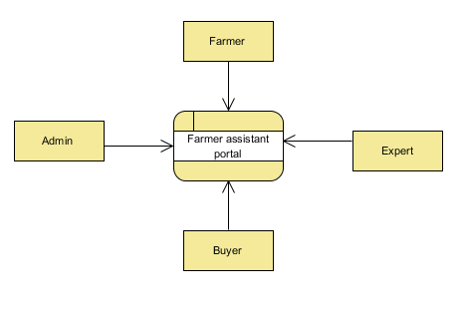
UML DIAGRAMS
Figure: Context Level diagram

Slide 43
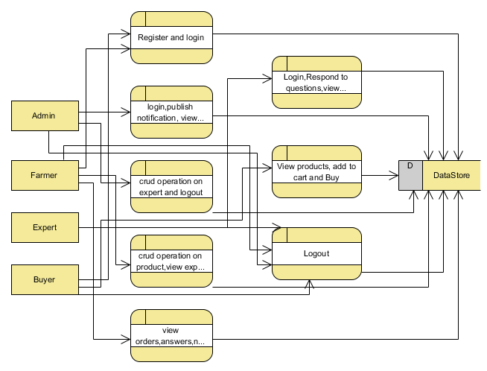
UML DIAGRAMS
FigureLevel-1 diagram

Slide 44
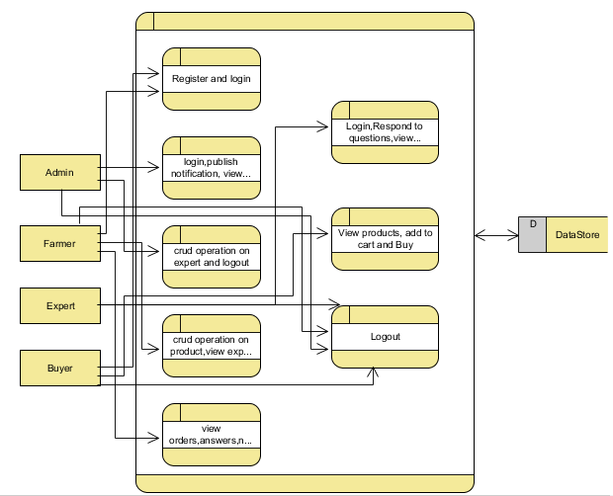
UML DIAGRAMS
Figure:Level-2 diagram

Slide 45
REFERENCES
[1] Manav Singhal, Kshitij Verma, Anupam Shukla, “Krishi Ville-Android based solution for Indian agriculture”. 2011 Fifth IEEE International Conference on Advanced Telecommunication Systems and Networks (ANTS), 18-21 Dec. 2011, Bangalore, India.
[2] Soumalya Ghosh, A. B. Garg, Sayan Sarcar, P.S.V.S Sridhar, Ojasvi Maleyvar, and Raveesh kapoor, “Krishi-Bharati: An Interface for Indian Farmer”, Proceedings of the 2014 IEEE Students' Technology Symposium, 28 Feb.-2 March 2014, Kharagpur, India.
[3] Shankar M. Patil, Monika Jadhav, Vishakha Jagtap, “Android Application for Farmers”, International Research Journal of Engineering and Technology, volume 6, issue 4, 2019, 4200-4202p.
[4] Shital Chaudhari, Vaishnavi Mhatre, Pooja Patil, Sandeep Chavan, “Smart Farm Application: A Modern Farming Technique Using Android Application”, International Research Journal of Engineering and Technology, volume 5, issue 2, 2018, 318-320p.

Slide 46
REFERENCES
[5] Arpit Narechania “KisanVikas – Android Based ICT Solution in Indian Agriculture to Assist Farmers”. Proceeding of the 7th International Conference on Information and Communication Technologies in Agriculture, Food and Environment (HAICTA 2015), Kavala, Greece, 17-20 September, 2015.
[6] Shaik. N. Meera, Anita Jhamtani, D.U.M. Rao (2004). Information and Communication Technology in Agricultural Development: A Comparative Analysis of Three Projects from India [Online] Available from: https://www.odi.org/sites/odi.org.uk/files/odi-assets/publications-opinion-files/5186.pdf [April 2020].
[7] Agro Products (2020). Origin of Agriculture. [Online] Available from:
http://www.agriculturalproductsindia.com/agro/history.html [Accessed April 2020].
[8] ICT in Agriculture (2020). National Round Table Conference. [Online] Available from: https://www.icfa.org.in/assets/doc/reports/ICT_in_Agriculture.pdf [Accessed April 2020].

